Slide 1

Reconocimiento de Patrones
Domingo Mery
Departamento de Ciencia de la Computación
Escuela de Ingeniería
Universidad Católica de Chile
Object Detection with SIFT
[ Capítulo 2 ]

Slide 2
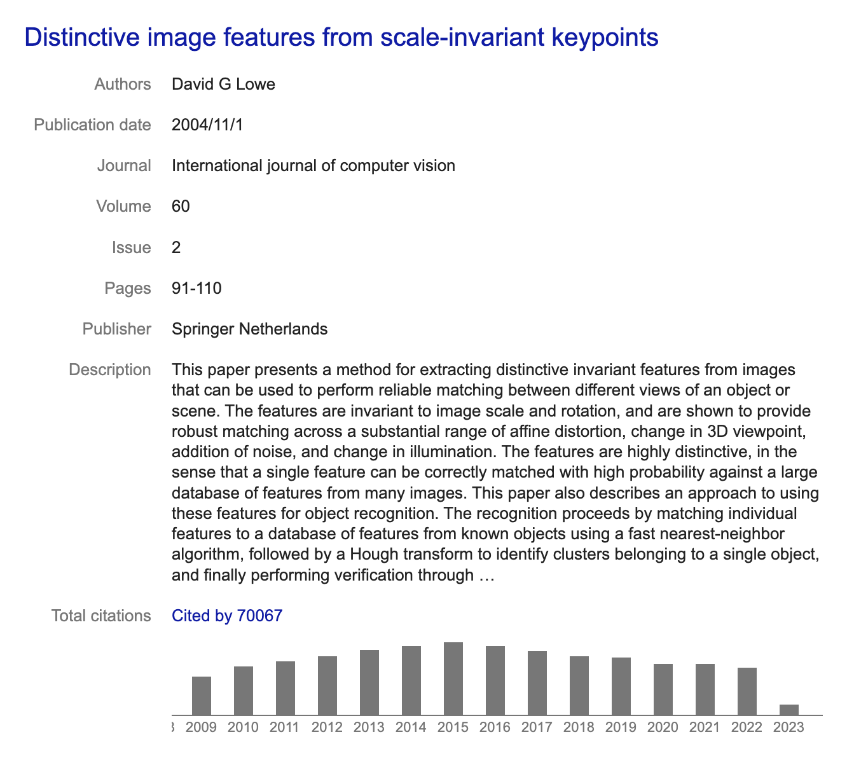

SIFT : Scale Invariant Feature Transform
D. G. Lowe. Distinctive image features from scale-invariant features. Intl. Journal of Computer Vision, 60(2):91-110, 2004.

Slide 3
Why SIFT?
PAT02_SIFT_ObjectDetection.pptx

Slide 4
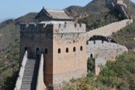
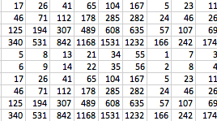
SIFT : Scale Invariant Feature Transform
128
keypoints
description
N
. . . . .. .
. . . . .
. .
. . . . .. .
. . . . .. .
. . . . .. .
Each keypoint is described as a
128-element vector
. . . . .. .
. . . . .. .
N keypoints
PAT02_SIFT_ObjectDetection.pptx

Slide 5
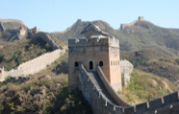
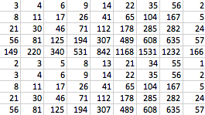

.
.
keypoints
description
.
.
keypoints
description
.
.
keypoints
description
128
.
.
1 | 3 | 5 | 17 | 23 | 21 | 45 | 11 | 15 | 7 | 67 | 56 | 12 | 87 | 56 | 34 | 12 | 15 | 19 | 9 | 7 | 79 | 19 | … | 25
1 | 4 | 5 | 15 | 23 | 22 | 45 | 12 | 16 | 8 | 68 | 58 | 12 | 86 | 56 | 33 | 12 | 16 | 19 | 10 | 8 | 78 | 17 | … | 22
2 | 4 | 6 | 17 | 21 | 21 | 46 | 11 | 14 | 7 | 66 | 56 | 11 | 87 | 56 | 35 | 12 | 11 | 19 | 9 | 6 | 79 | 18 | … | 24
.
PAT02_SIFT_ObjectDetection.pptx

Slide 6
.
.
keypoints
description
.
keypoints
description
.
.
.
keypoints
description
128
.
.
1 | 3 | 5 | 17 | 23 | 21 | 45 | 11 | 15 | 7 | 67 | 56 | 12 | 87 | 56 | 34 | 12 | 15 | 19 | 9 | 7 | 79 | 19 | … | 25
23 | 65 | 32 | 90 | 76 | 56 | 34 | 98 | 6 | 8 | 56 | 8 | 9 | 23 | 8 | 45 | 2 | 43 | 67 | 19 | 62 | 78 | 55 | … | 7
99 | 76 | 34 | 12 | 98 | 76 | 90 | 55 | 43 | 87 | 65 | 43 | 32 | 65 | 7 | 9 | 1 | 3 | 45 | 66 | 39 | 18 | 39 | … | 78
.

Slide 7
SIFT
It is used to detect keypoints
Each keypoint is described using a 128-element vector called ‘SIFT-descriptor’
SIFT-descriptor is:
Scale invariant
Rotation invariant
Illumination invariant
Viewpoint invariant
SIFT-descriptor is like a ‘signature’:
SIFT-descriptors of the same point (in different images) are very similar.
SIFT-descriptors of different points are very different.
PAT02_SIFT_ObjectDetection.pptx

Slide 8
Detection of Keypoints
PAT02_SIFT_ObjectDetection.pptx

Slide 9

A synthetic image with a spot
Two goals:
Where?
Size?
.
PAT02_SIFT_ObjectDetection.pptx

Slide 10
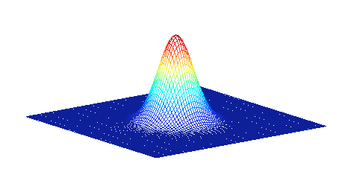
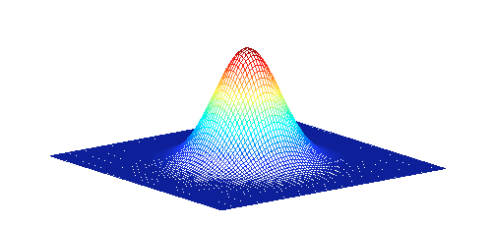
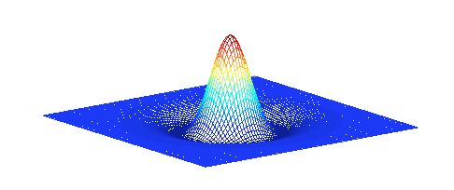
For the detection a DoG – Mask is used:
G1 = Gaussian 1 (with σ) G2 = Gaussian 2 (with kσ)
Difference of Gaussians (DoG): G2-G1
PAT02_SIFT_ObjectDetection.pptx

Slide 11
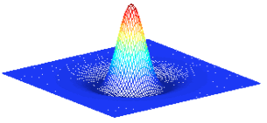


DoG Mask
★
★ : Convolution

Slide 12
★
PAT02_SIFT_ObjectDetection.pptx

Slide 13
★
PAT02_SIFT_ObjectDetection.pptx

Slide 14
Input
with DoG of different σ
=
Outputs
PAT02_SIFT_ObjectDetection.pptx

Slide 15
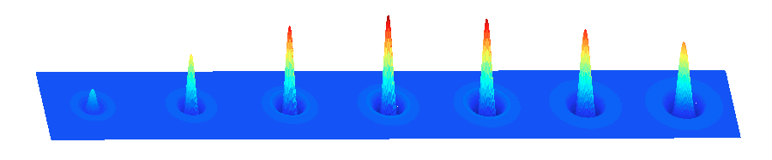
σ'
Location: Where is the maximum?
Scale: Which mask?
PAT02_SIFT_ObjectDetection.pptx

Slide 16
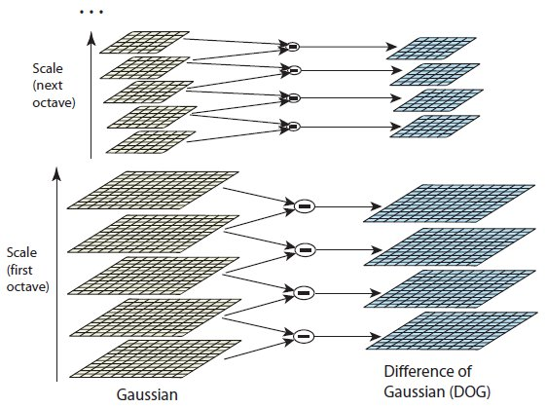
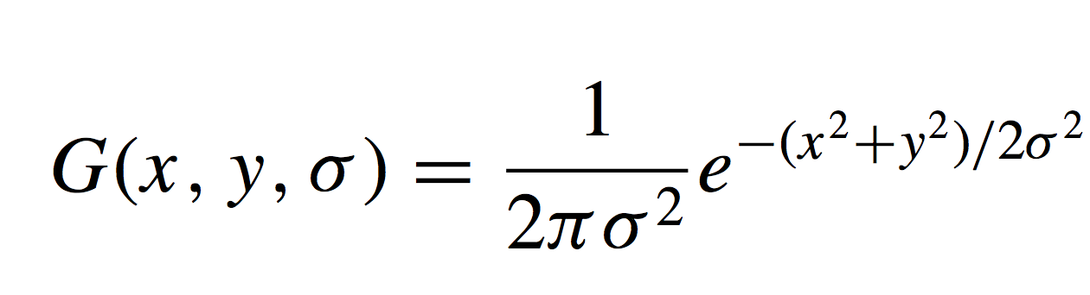
SIFT : Scale Invariant Feature Transform
© Lowe
.........
.........
.........
.........
PAT02_SIFT_ObjectDetection.pptx

Slide 17
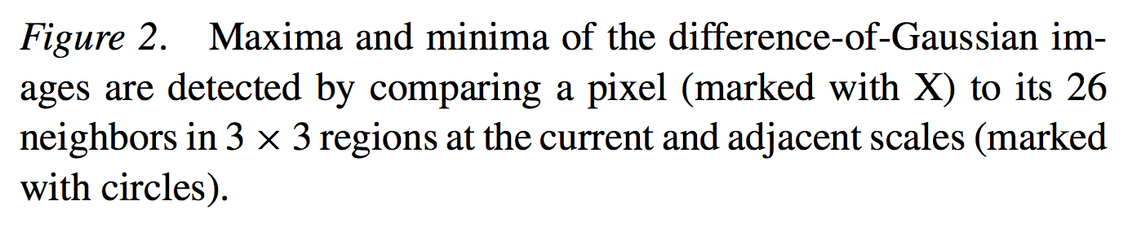
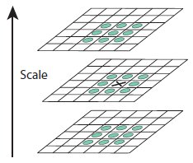
SIFT : Scale Invariant Feature Transform
© Lowe
.........
.........
.........
.........
.........
PAT02_SIFT_ObjectDetection.pptx

Slide 18
SIFT : Scale Invariant Feature Transform
© Lowe
PAT02_SIFT_ObjectDetection.pptx

Slide 19
MATLAB Demo
PAT02_SIFT_DoG_Keypoints.m
PAT02_SIFT_ObjectDetection.pptx

Slide 20
Descriptor of a Keypoint
PAT02_SIFT_ObjectDetection.pptx

Slide 21
First, we have to understand what is a Histogram of Gradients
PAT02_SIFT_ObjectDetection.pptx

Slide 22
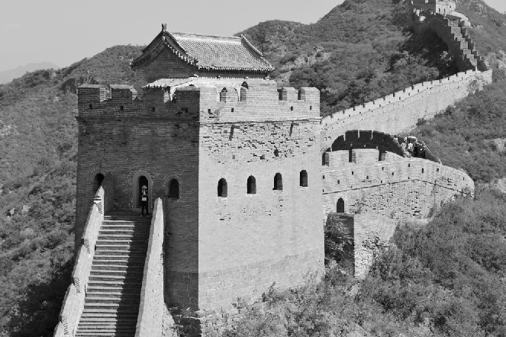
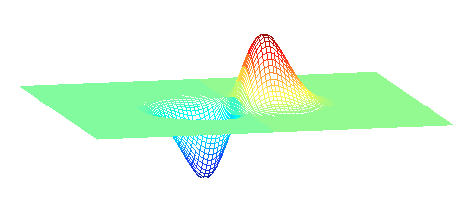
Histogram of Gradients
Gradient in x
direction
G_{x}
Gradient in y
direction
G_{y}
σ'
★ [ -1 0 1] =
★ : Convolution

Slide 23
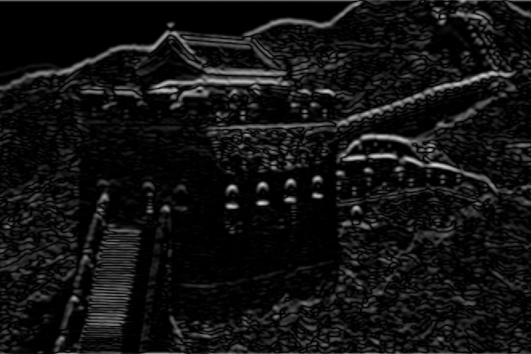
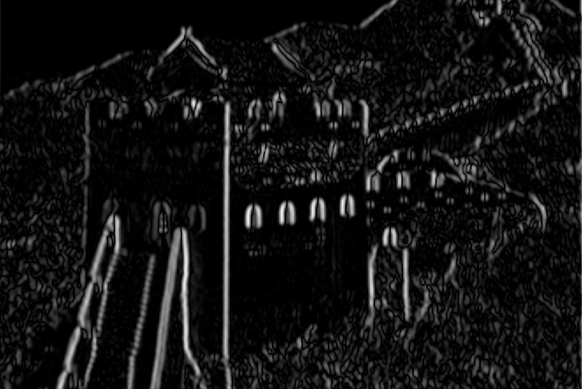
Histogram of Gradients
G_{x}: Gradient in x direction
Magnitude
R
= sqrt(G_{x}²+G_{y}²)
G_{y}: Gradient in y direction
Angle
A
= arctan(Gy/G_{x})
PAT02_SIFT_ObjectDetection.pptx

Slide 24
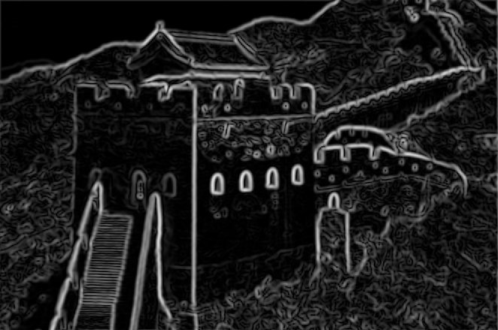
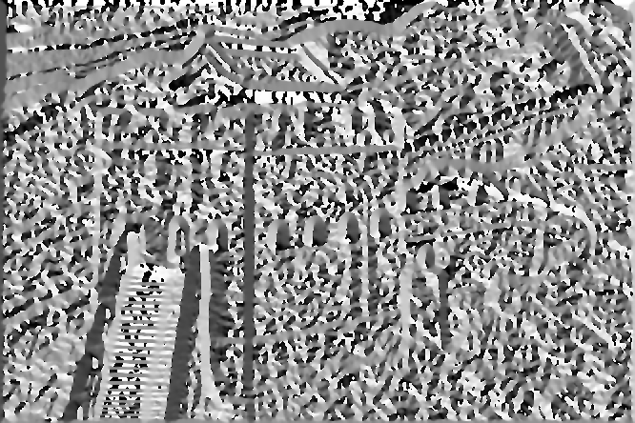
Histogram of Gradients
R: Magnitude
Histogram of 8 directions
3
4
2
A: Angle
5
1
6
8
7
PAT02_SIFT_ObjectDetection.pptx
1 2 3 4 5 6 7 8

Slide 25
Histogram of Gradients
R: Magnitude
Histogram of 8 directions
(computation of first bin)
3
4
2
A: Angle
5
1
6
8
7
PAT02_SIFT_ObjectDetection.pptx
1 2 3 4 5 6 7 8

Slide 26
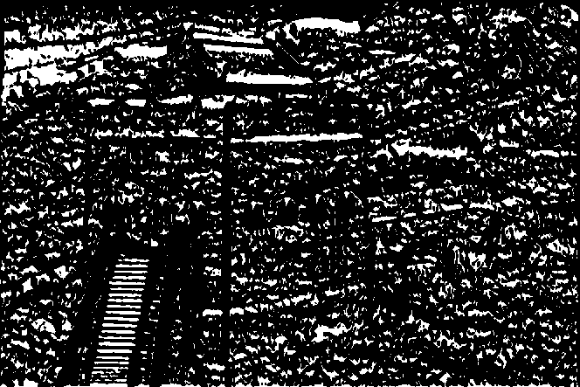
Histogram of Gradients
R: Magnitude
Histogram of 8 directions
(computation of first bin)
3
4
2
22.5º
A: Angle between -22.5º and 22.5º
5
1
-22.5º
6
8
7
PAT02_SIFT_ObjectDetection.pptx
1 2 3 4 5 6 7 8

Slide 27
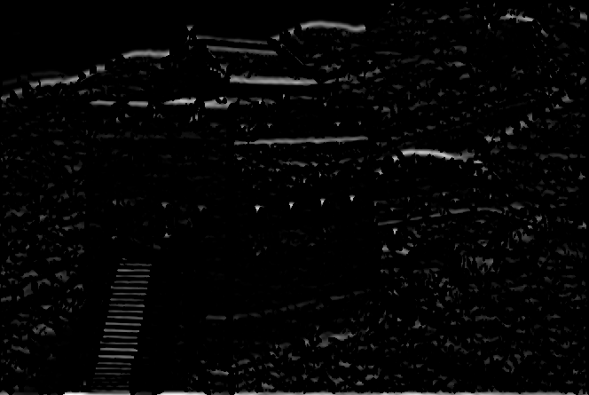
Histogram of Gradients
R: Magnitude in this direction
Histogram of 8 directions
(computation of first bin)
3
4
2
22.5º
A: Angle between -22.5º and 22.5º
5
1
Σ
-22.5º
6
8
7
PAT02_SIFT_ObjectDetection.pptx
1 2 3 4 5 6 7 8

Slide 28

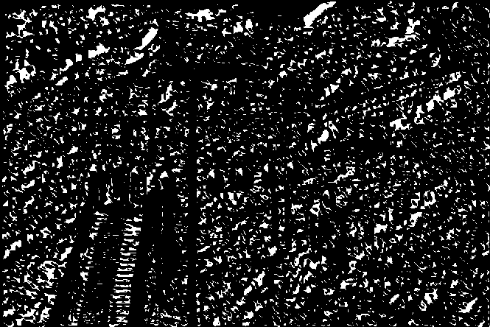
Histogram of Gradients
R: Magnitude in this direction
Histogram of 8 directions
(computation of second bin)
3
67.5º
4
2
22.5º
A: Angle between 22.5º and 67.5º
5
1
Σ
6
8
7
etc.
PAT02_SIFT_ObjectDetection.pptx
1 2 3 4 5 6 7 8

Slide 29
Histogram of Gradients
R: Magnitude
Histogram of 8 directions
3
4
2
A: Angle
5
1
6
8
7
PAT02_SIFT_ObjectDetection.pptx
1 2 3 4 5 6 7 8

Slide 30
Now, we can understand how to build the SIFT descriptor
PAT02_SIFT_ObjectDetection.pptx

Slide 31
How to build the descriptor?
Find a keypoint (x,y,σ’)
.
PAT02_SIFT_ObjectDetection.pptx

Slide 32
How to build the descriptor?
Find a keypoint (x,y,σ’)
Find the orientation using A(x,y) matrix
.
PAT02_SIFT_ObjectDetection.pptx

Slide 33
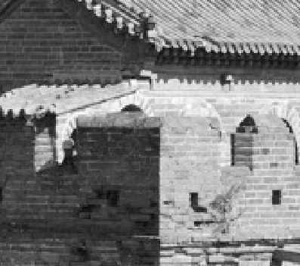
How to build the descriptor?
Find a keypoint (x,y,σ’)
Find the orientation using A(x,y) matrix
Take a window centered in the keypoint of size 1.5 σ’.
.
PAT02_SIFT_ObjectDetection.pptx

Slide 34
How to build the descriptor?
Find a keypoint (x,y,σ’)
Find the orientation using A(x,y) matrix
Take a window centered in the keypoint of size 1.5 σ’.
Align the window to direction ‘1’.
8 directions
3
4
2
5
1
6
8
7
PAT02_SIFT_ObjectDetection.pptx

Slide 35
How to build the descriptor?
Find a keypoint (x,y,σ’)
Find the orientation using A(x,y) matrix
Take a window centered in the keypoint of size 1.5 σ’.
Align the window to direction ‘1’.
8 directions
2 3 4
5 6 7 8
9 10 11 12
13 14 15 16
3
4
2
.
5
1
6
8
7
5. Define 16 partitions
PAT02_SIFT_ObjectDetection.pptx

Slide 36
How to build the descriptor?
Find a keypoint (x,y,σ’)
Find the orientation using A(x,y) matrix
Take a window centered in the keypoint of size 1.5 σ’.
Align the window to direction ‘1’.
8 directions
2 3 4
5 6 7 8
9 10 11 12
13 14 15 16
3
4
2
.
5
1
6
8
7
Define 16 partitions
Compute 8 bin histograms in each partition

Slide 37
How to build the descriptor?
Find a keypoint (x,y,σ’)
Find the orientation using A(x,y) matrix
Take a window centered in the keypoint of size 1.5 σ’.
Align the window to direction ‘1’.
2 3 4
5 6 7 8
9 10 11 12
13 14 15 16
Define 16 partitions
Compute 8 bin histograms in each partition

Slide 38
How to build the descriptor?
7. Concatenate all histograms
2 3 4 . . . 13 14 15 16
16 x 8 = 128
PAT02_SIFT_ObjectDetection.pptx

Slide 39
How to build the descriptor?
Concatenate all histograms
8. Normalize
2 3 4 . . . 13 14 15 16
16 x 8 = 128
norm = 1
PAT02_SIFT_ObjectDetection.pptx

Slide 40
How to build the descriptor?
Concatenate all histograms
8. Normalize
9. The End
2 3 4 . . . 13 14 15 16
16 x 8 = 128
norm = 1
PAT02_SIFT_ObjectDetection.pptx

Slide 41
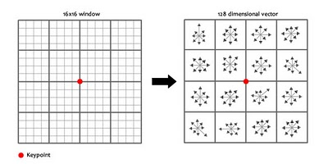
SIFT : Scale Invariant Feature Transform
© Lowe
Each keypoint is described as a 128-element vector
A. Saharkhiz: Details behind SIFT
http://areshmatlab.blogspot.com/2010/07/details-behind-sift-feature-detection.html

Slide 42
Find a keypoint (x,y,σ’)
Find the orientation using A(x,y) matrix
Take a window centered in the keypoint of size 1.5 σ’.
Align the window to direction ‘1’.
Define 16 partitions
Compute 8 bin histograms in each partition
Concatenate all histograms
Normalize
Why is SIFT-descriptor … ?
Scale invariant
Rotation invariant
Illumination invariant
Viewpoint invariant

Slide 43
Find a keypoint (x,y,σ’)
Find the orientation using A(x,y) matrix
Take a window centered in the keypoint of size 1.5 σ’.
Align the window to direction ‘1’.
Define 16 partitions
Compute 8 bin histograms in each partition
Concatenate all histograms
Normalize
Why is SIFT-descriptor … ?
Scale invariant
Rotation invariant
Illumination invariant
Viewpoint invariant

Slide 44
Example
PAT02_SIFT_ObjectDetection.pptx

Slide 45
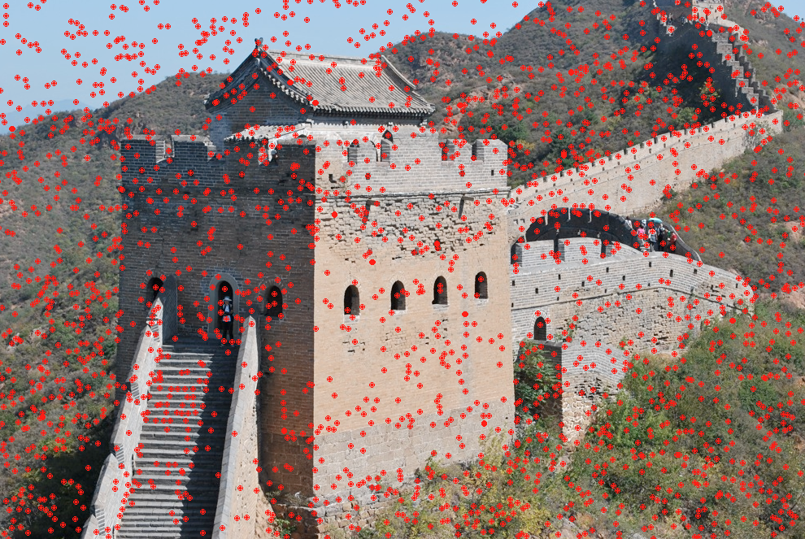
SIFT keypoints

Slide 46
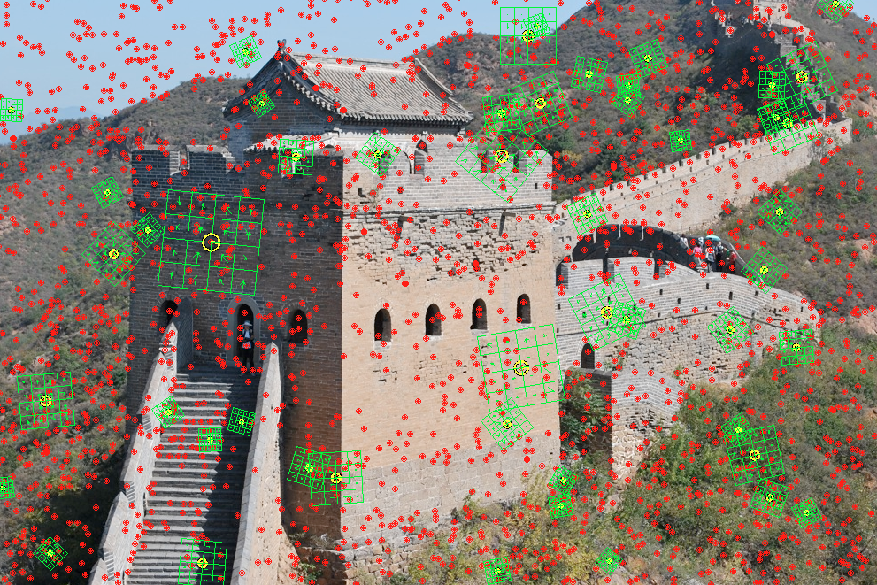
SIFT keypoints and descriptors

Slide 47
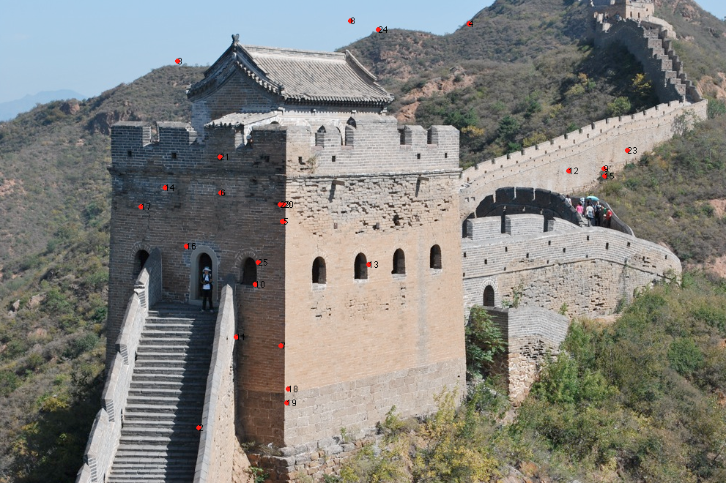
SIFT matching points in image 1

Slide 48
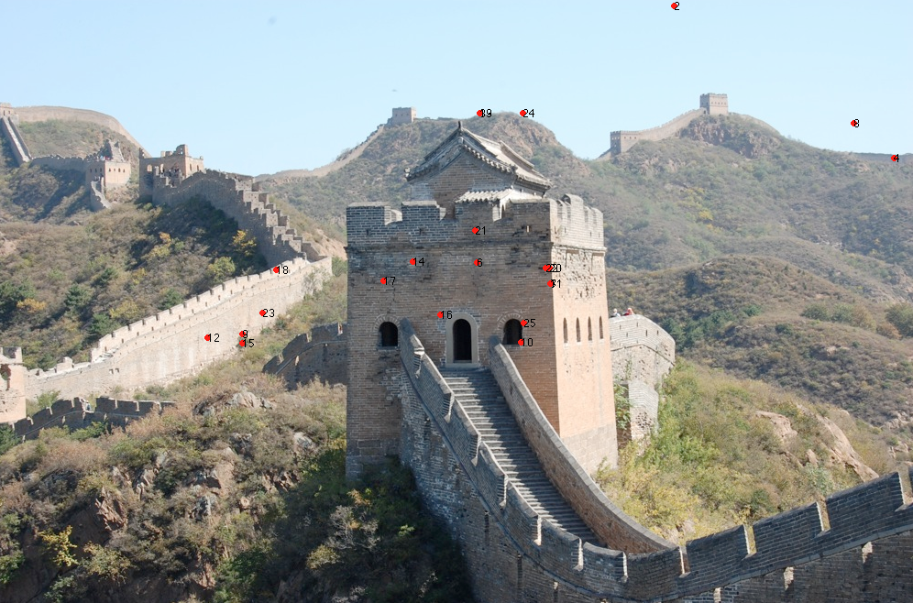
SIFT matching points in image 2

Slide 49
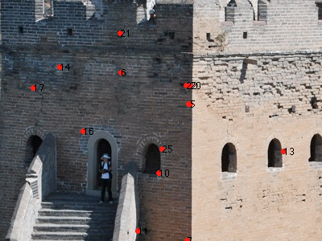
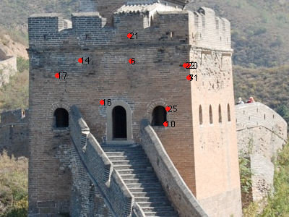
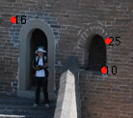
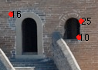
SIFT matching points in images 1 and 2

Slide 50
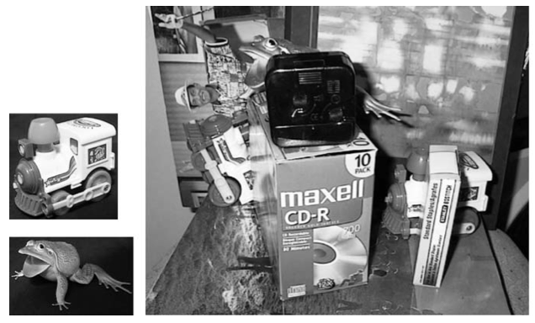
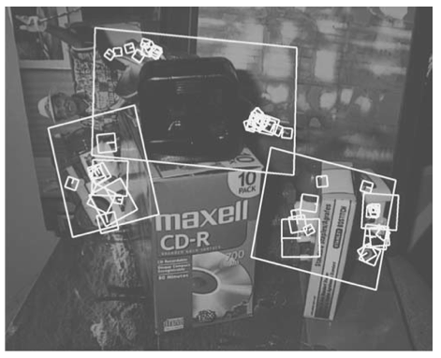
© Lowe
PAT02_SIFT_ObjectDetection.pptx

Slide 51
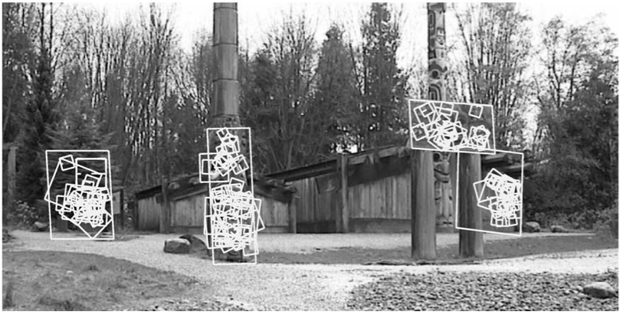
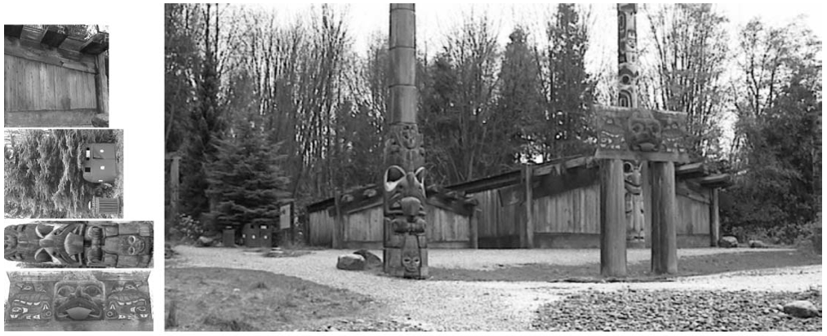
© Lowe
PAT02_SIFT_ObjectDetection.pptx

Slide 52

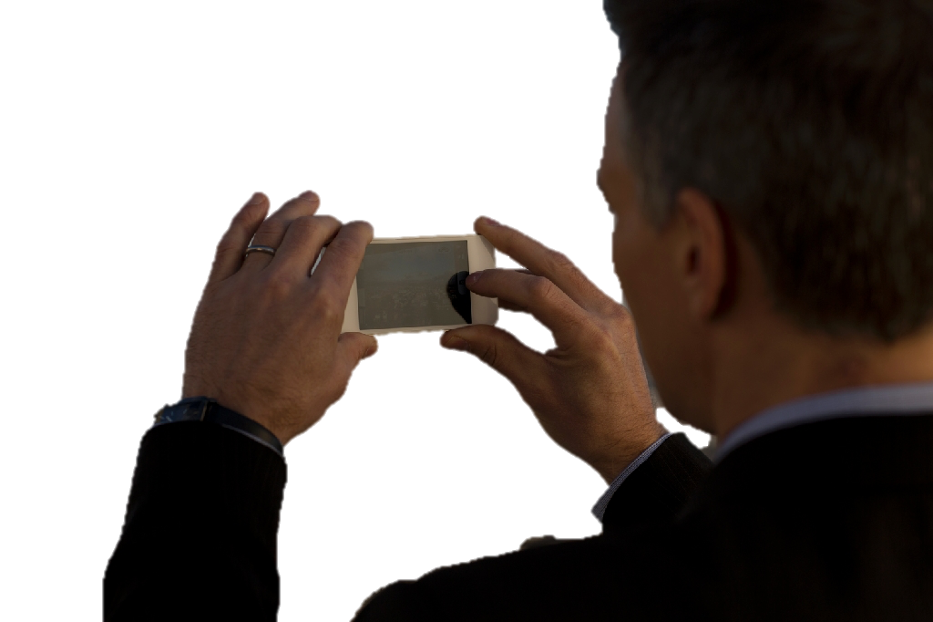
Applications: Vivino
PAT02_SIFT_ObjectDetection.pptx

Slide 53



Applications: Amazon
PAT02_SIFT_ObjectDetection.pptx

